Slide 1
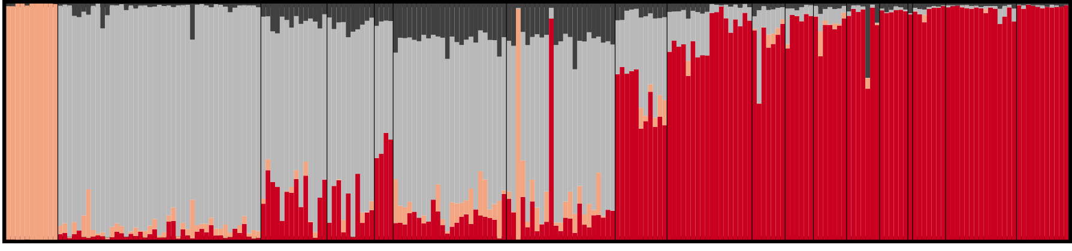
Lab 10: Inference of population structure
BIOL4174/5174 Conservation Genetics Spring 2018

Slide 2
Population structure
Populations generally don’t consist of a single randomly-mating unit
Assortative mating due to:
Dispersal limitation
Geographic barriers
Differential adaptation
etc
Byrne et al (2018) PLoS Genetics

Slide 3
Inferring population structure
Most common approaches:
Approaches we’ve seen (genetic distances, F-statistics, AMOVA, etc)
Phylogenetic approaches (may not be informative at sub-specific scale)
Principle Components Analysis (PCA) / Dimension reduction approaches
Assignment Tests

Slide 4
Inferring population structure: PCA
Genetic data is very large
Sometimes hundreds or thousands of loci
Individuals are described by multi-dimensional vector of marker configurations
Low-dimensional projection can help see patterns
PCA: One of many methods which can be used to highlight patterns in highly dimensional datasets
Find major axes of variation in multidimensional datasets
Allows to transform data and visualize pattern

Slide 5
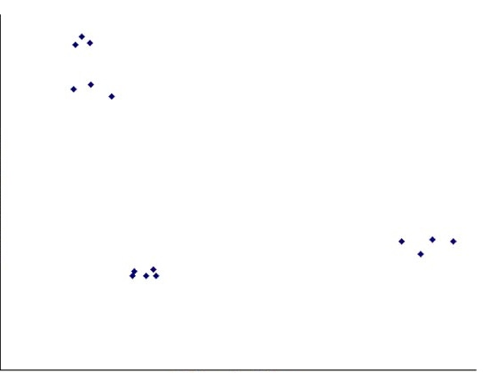
Two-Dimensional Example

Slide 6
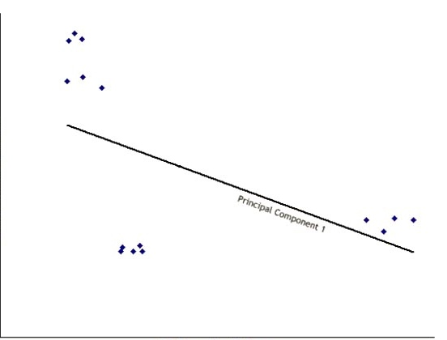
Two-Dimensional Example

Slide 7
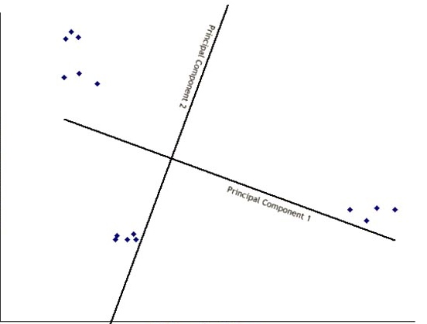
Two-Dimensional Example

Slide 8
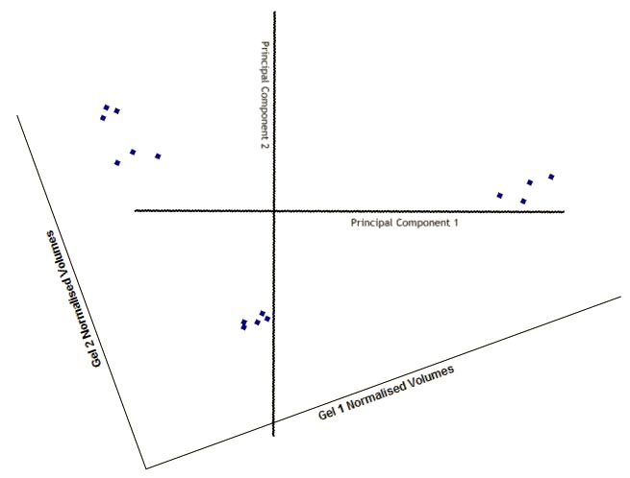
Two-Dimensional Example

Slide 9
Inferring population structure: PCA
Most commonly applied of this type of analysis
Find new dimensions (Principal Components) which:
Are linear combinations of the original ones
Are uncorrelated with one another
Capture as much variance in the original data as possible

Slide 10
Inferring population structure: PCA
Steps
Calculate covariance matrix (=joint variability)
Find vectors (axis) explaining covariance from this matrix
These are called eigenvectors
Each has an associated eigenvalue describing how much variance it explains
Eigenvectors are orthogonal, or perpendicular to one another
Sort eigenvectors by percentage variation explained
First few axes usually explain majority of variation
Eigenvector explaining the most variation is Principal Component 1 (and same for PC2, etc…)
Often components of very little significant are ignored

Slide 11
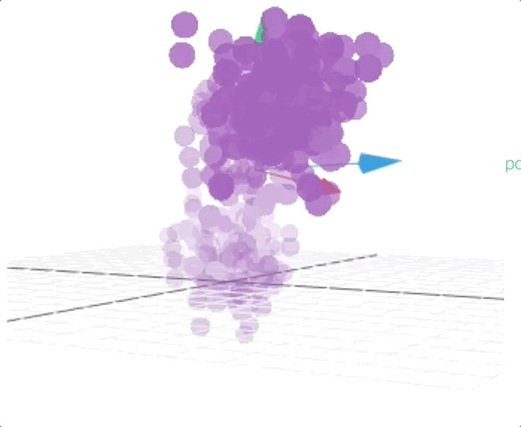
Inferring population structure: PCA
http://setosa.io/ev/principal-component-analysis/

Slide 12
Inferring structure: Assignment Tests
Used to assign ancestry to individuals, given allele frequencies for populations
Can be used to infer admixture, gene flow between populations
Commonly used methods:
Bayesian: Structure, BAPS, Structurama, fastStructure
Bayesian with geographical constraints: TESS, GENELAND
Likelihood: Admixture

Slide 13
Inferring structure: Assignment Tests
Used to assign ancestry to individuals, given allele frequencies for populations
Can be used to infer admixture, gene flow between populations
Commonly used methods:
Bayesian: Structure, BAPS, Structurama, fastStructure
Bayesian with geographical constraints: TESS, GENELAND
Likelihood: Admixture

Slide 14
Given two populations with allele frequencies:
 | SNP 1 | SNP 2 | SNP 3 | SNP 4
 | A/T | G/C | T/C | T/G | …
Pop1 | 0.6/0.4 | 0.9/0.1 | 0.7/0.3 | 0.4/0.6 | …
Pop2 | 0.5/0.5 | 0.3/0.7 | 0.8/0.2 | 0.1/0.9 | …

Slide 15
And an individual (X) of unknown origin:
 | SNP 1 | SNP 2 | SNP 3 | SNP 4
Ind X | A/T | G/G | T/T | T/G | …

Slide 16
And an individual (X) of unknown origin:
 | SNP 1 | SNP 2 | SNP 3 | SNP 4
Ind X | A/T | G/G | T/T | T/G | …
What is the probability Individual X came from Population 1?

Slide 17
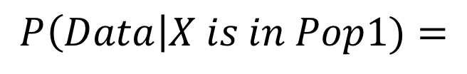
 | SNP 1 | SNP 2 | SNP 3 | SNP 4
 | A/T | G/C | T/C | T/G | …
Pop1 | 0.6/0.4 | 0.9/0.1 | 0.7/0.3 | 0.4/0.6 | …
Pop2 | 0.5/0.5 | 0.3/0.7 | 0.8/0.2 | 0.1/0.9 | …
Ind X
Ind X | A/T | G/G | T/T | T/G | …
$$P\left(Data\right|X is in Pop1)=$$

Slide 18
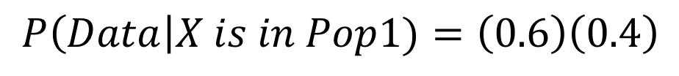
 | SNP 1 | SNP 2 | SNP 3 | SNP 4
 | A/T | G/C | T/C | T/G | …
Pop1 | 0.6/0.4 | 0.9/0.1 | 0.7/0.3 | 0.4/0.6 | …
Pop2 | 0.5/0.5 | 0.3/0.7 | 0.8/0.2 | 0.1/0.9 | …
Ind X
Ind X | A/T | G/G | T/T | T/G | …
A
T
$$P\left(Data\right|X is in Pop1)=\left(0.6\right)\left(0.4\right)$$
The probability of genotype A/T being sampled from Population 1, is the product of the probabilities of sampling an A, and sampling a T

Slide 19
 | SNP 1 | SNP 2 | SNP 3 | SNP 4
 | A/T | G/C | T/C | T/G | …
Pop1 | 0.6/0.4 | 0.9/0.1 | 0.7/0.3 | 0.4/0.6 | …
Pop2 | 0.5/0.5 | 0.3/0.7 | 0.8/0.2 | 0.1/0.9 | …
Ind X
Ind X | A/T | G/G | T/T | T/G | …
A
T
$$P\left(Data\right|X is in Pop1)=\left(0.6\right)\left(0.4\right)$$
$$P\left(SNP1=A/T\right|X is in Pop1)=0.24$$

Slide 20
 | SNP 1 | SNP 2 | SNP 3 | SNP 4
 | A/T | G/C | T/C | T/G | …
Pop1 | 0.6/0.4 | 0.9/0.1 | 0.7/0.3 | 0.4/0.6 | …
Pop2 | 0.5/0.5 | 0.3/0.7 | 0.8/0.2 | 0.1/0.9 | …
Ind X
Ind X | A/T | G/G | T/T | T/G | …
G
G
$$P\left(Data\right|X is in Pop1)=\left(0.6\right)\left(0.4\right)\left(0.9\right)\left(0.9\right)$$
Repeat for each locus…

Slide 21
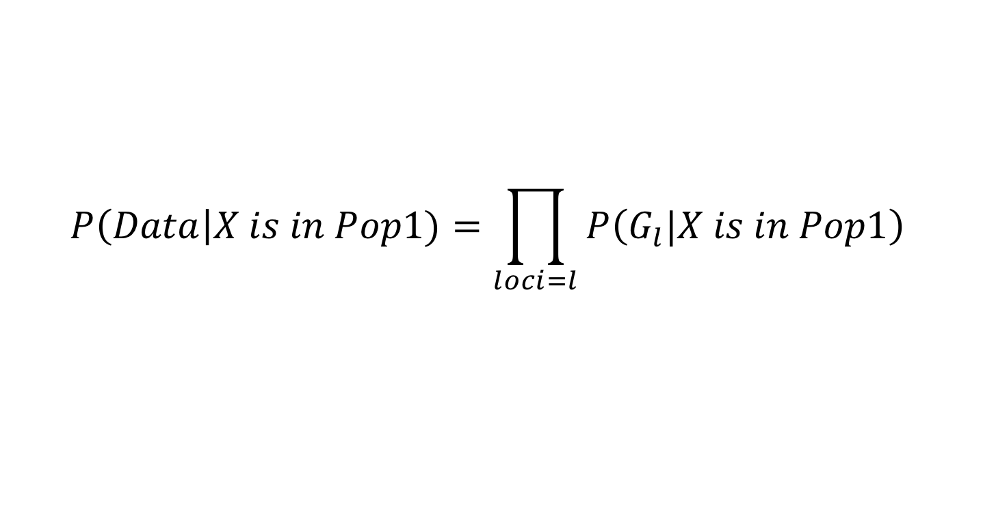
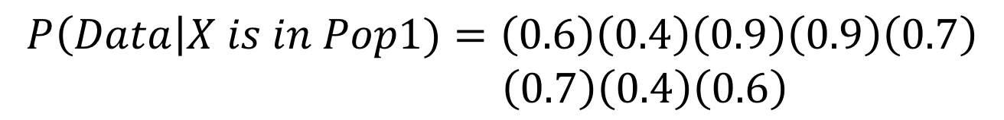
 | SNP 1 | SNP 2 | SNP 3 | SNP 4
 | A/T | G/C | T/C | T/G | …
Pop1 | 0.6/0.4 | 0.9/0.1 | 0.7/0.3 | 0.4/0.6 | …
Pop2 | 0.5/0.5 | 0.3/0.7 | 0.8/0.2 | 0.1/0.9 | …
Ind X
Ind X | A/T | G/G | T/T | T/G | …
$$P\left(Data\right|X is in Pop1)=\left(0.6\right)\left(0.4\right)\left(0.9\right)\left(0.9\right)\left(0.7\right)$$
$\left(0.7\right)\left(0.4\right)\left(0.6\right)$
$$P\left(Data\right|X is in Pop1)=\prod_{loci=l}{P\left(G_{l}|X is in Pop1\right)}$$

Slide 22

 | SNP 1 | SNP 2 | SNP 3 | SNP 4
 | A/T | G/C | T/C | T/G | …
Pop1 | 0.6/0.4 | 0.9/0.1 | 0.7/0.3 | 0.4/0.6 | …
Pop2 | 0.5/0.5 | 0.3/0.7 | 0.8/0.2 | 0.1/0.9 | …
Ind X
Ind X | A/T | G/G | T/T | T/G | …
$$P\left(Data\right|X is in Pop1)=\left(0.6\right)\left(0.4\right)\left(0.9\right)\left(0.9\right)\left(0.7\right)$$
$\left(0.7\right)\left(0.4\right)\left(0.6\right)$
$$P\left(Data\right|X is in Pop1)=\prod_{loci=l}{P\left(G_{l}|X is in Pop1\right)}$$
$$=0.04000752$$

Slide 23
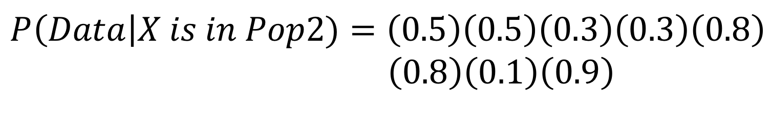

 | SNP 1 | SNP 2 | SNP 3 | SNP 4
 | A/T | G/C | T/C | T/G | …
Pop1 | 0.6/0.4 | 0.9/0.1 | 0.7/0.3 | 0.4/0.6 | …
Pop2 | 0.5/0.5 | 0.3/0.7 | 0.8/0.2 | 0.1/0.9 | …
Ind X
Ind X | A/T | G/G | T/T | T/G | …
What about Pop 2?
$$=0.001296$$

Slide 24
 | SNP 1 | SNP 2 | SNP 3 | SNP 4
 | A/T | G/C | T/C | T/G | …
Pop1 | 0.6/0.4 | 0.9/0.1 | 0.7/0.3 | 0.4/0.6 | …
Pop2 | 0.5/0.5 | 0.3/0.7 | 0.8/0.2 | 0.1/0.9 | …
Ind X
Ind X | A/T | G/G | T/T | T/G | …
$$P\left(Data\right|X is in Pop1)=0.04000752$$
$$P\left(Data\right|X is in Pop2)=0.001296$$
ML assignment to Pop 1…

Slide 25
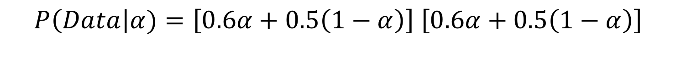
 | SNP 1 | SNP 2 | SNP 3 | SNP 4
 | A/T | G/C | T/C | T/G | …
Pop1 | 0.6/0.4 | 0.9/0.1 | 0.7/0.3 | 0.4/0.6 | …
Pop2 | 0.5/0.5 | 0.3/0.7 | 0.8/0.2 | 0.1/0.9 | …
Ind X
Ind X | A/T | G/G | T/T | T/G | …
Extending to the case of admixture…
If an individual has 𝛼 ancestry from Pop 1 and 1- 𝛼 ancestry from Pop 2:
A from Pop1 OR Pop2
T from Pop1 OR Pop2
$P\left(Data\right|α)=\left[0.6α+0.5\left(1−α\right)\right]$ $\left[0.6α+0.5\left(1−α\right)\right]$

Slide 26
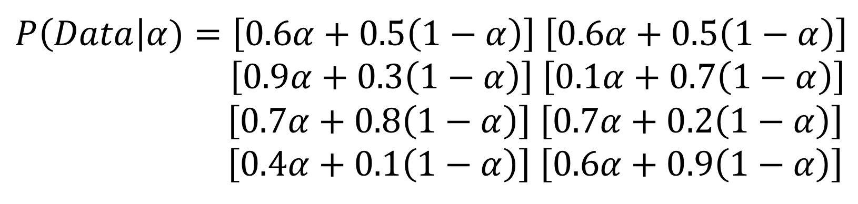
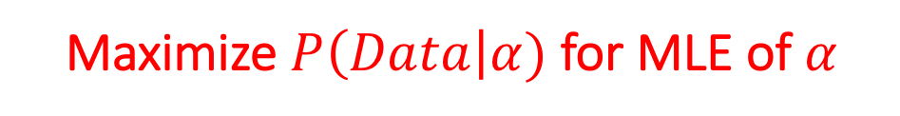
 | SNP 1 | SNP 2 | SNP 3 | SNP 4
 | A/T | G/C | T/C | T/G | …
Pop1 | 0.6/0.4 | 0.9/0.1 | 0.7/0.3 | 0.4/0.6 | …
Pop2 | 0.5/0.5 | 0.3/0.7 | 0.8/0.2 | 0.1/0.9 | …
Ind X
Ind X | A/T | G/G | T/T | T/G | …
Maximize $P\left(Data\right|α)$ for MLE of 𝛼

Slide 27
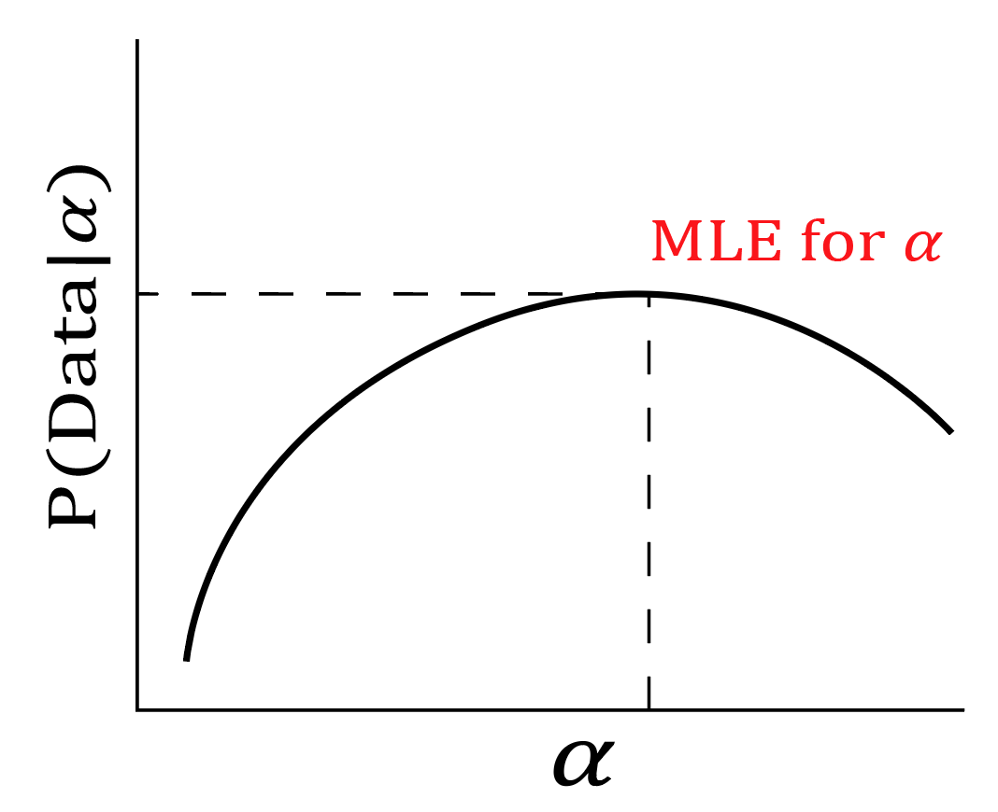

Slide 28
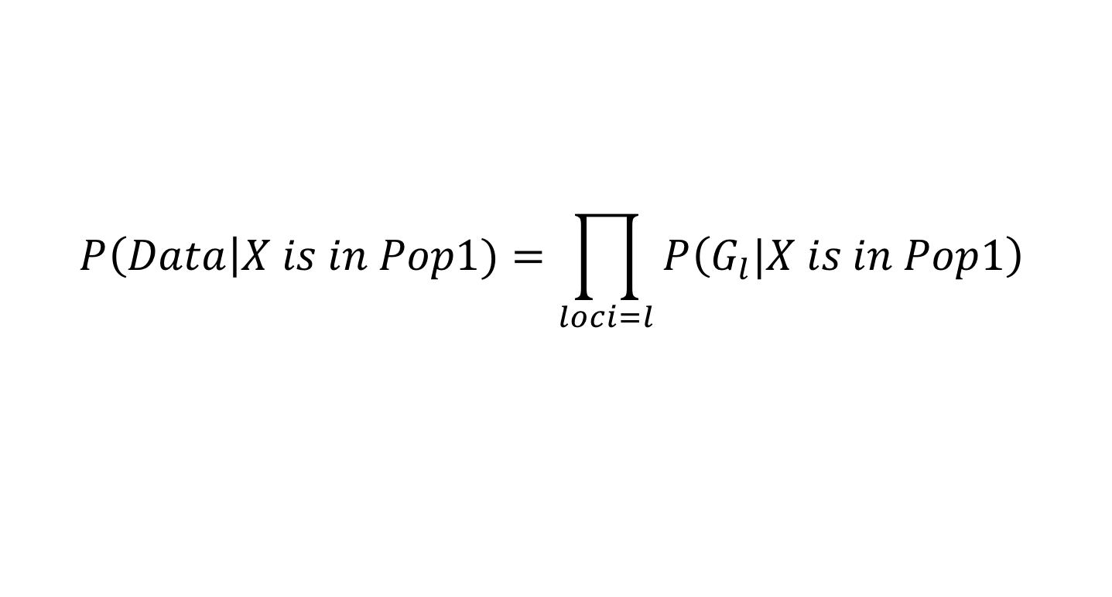
What’s the point??
1. We make several assumptions when calculating likelihoods of assignment
$$P\left(Data\right|X is in Pop1)=\prod_{loci=l}{P\left(G_{l}|X is in Pop1\right)}$$

Slide 29
What’s the point??
1. We make several assumptions when calculating likelihoods of assignment
$$P\left(Data\right|X is in Pop1)=\prod_{loci=l}{P\left(G_{l}|X is in Pop1\right)}$$
Assumes no LD
Assumes no assortative mating (HWE)

Slide 30
What’s the point??
2. We make can easily assign individuals to populations, when allele frequencies are known (even accounting for admixture)…
$$P\left(Data\right|X is in Pop1)=\prod_{loci=l}{P\left(G_{l}|X is in Pop1\right)}$$

Slide 31
What’s the point??
3. …OR we can easily calculate allele frequencies of populations when individual assignments are known.
 | SNP 1 | SNP 2 | SNP 3 | SNP 4
 | A/T | G/C | T/C | T/G | …
Pop1 | 0.6/0.4 | 0.9/0.1 | 0.7/0.3 | 0.4/0.6 | …
Pop2 | 0.5/0.5 | 0.3/0.7 | 0.8/0.2 | 0.1/0.9 | …

Slide 32
What’s the point??
What about when we don’t know populations a priori??

Slide 33
What’s the point??
What about when we don’t know populations a priori??
Structure (Pritchard et al 2000) uses Bayes Theorem and MCMC to come up with joint estimates of both

Slide 34
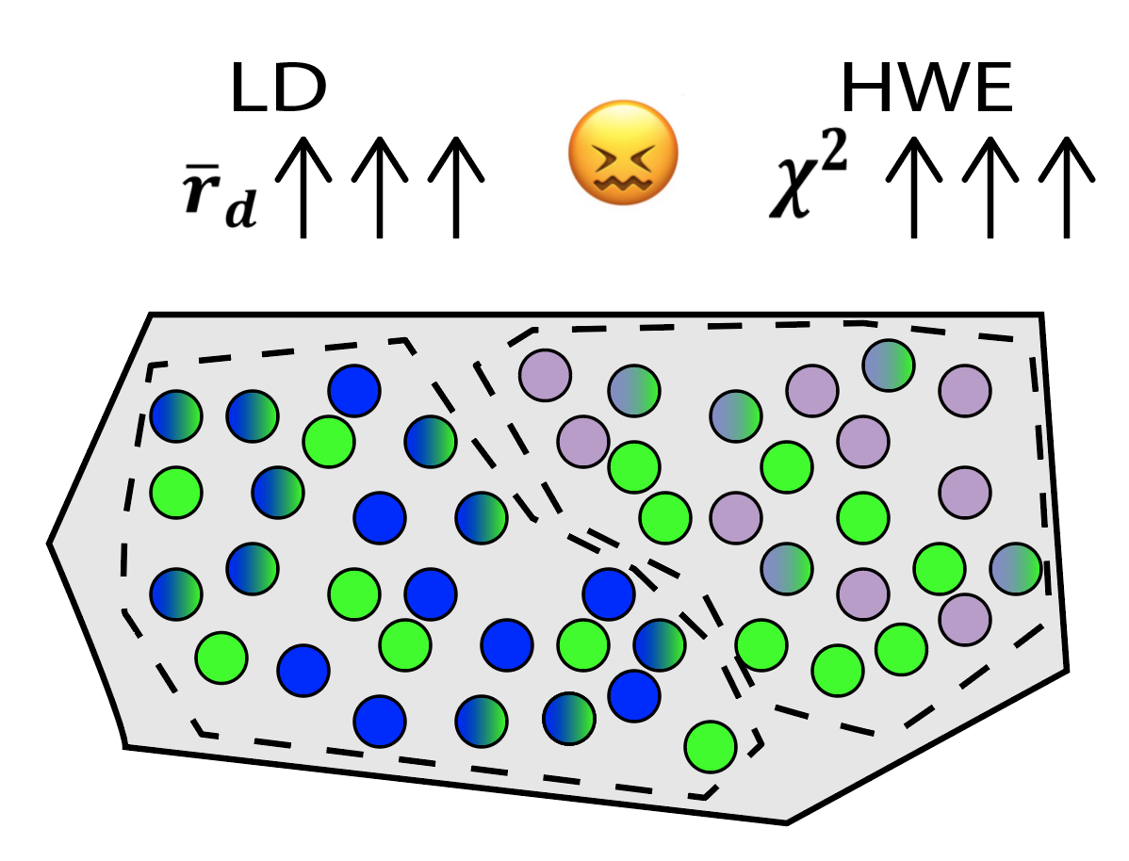

Slide 35
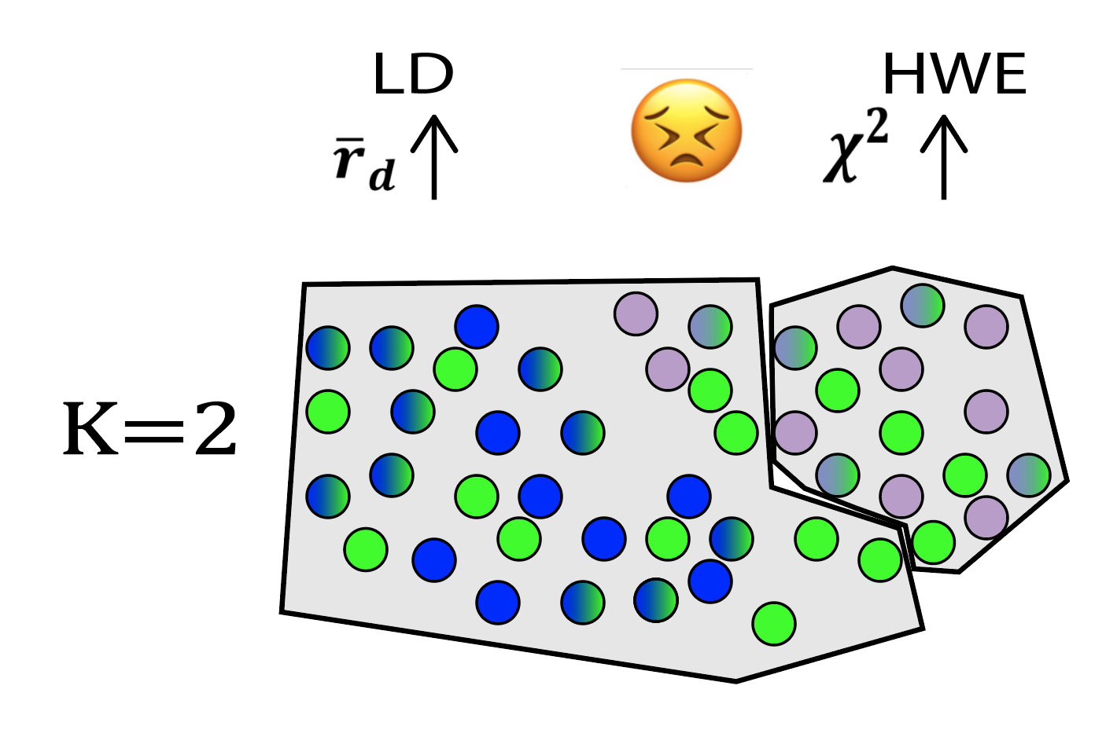

Slide 36
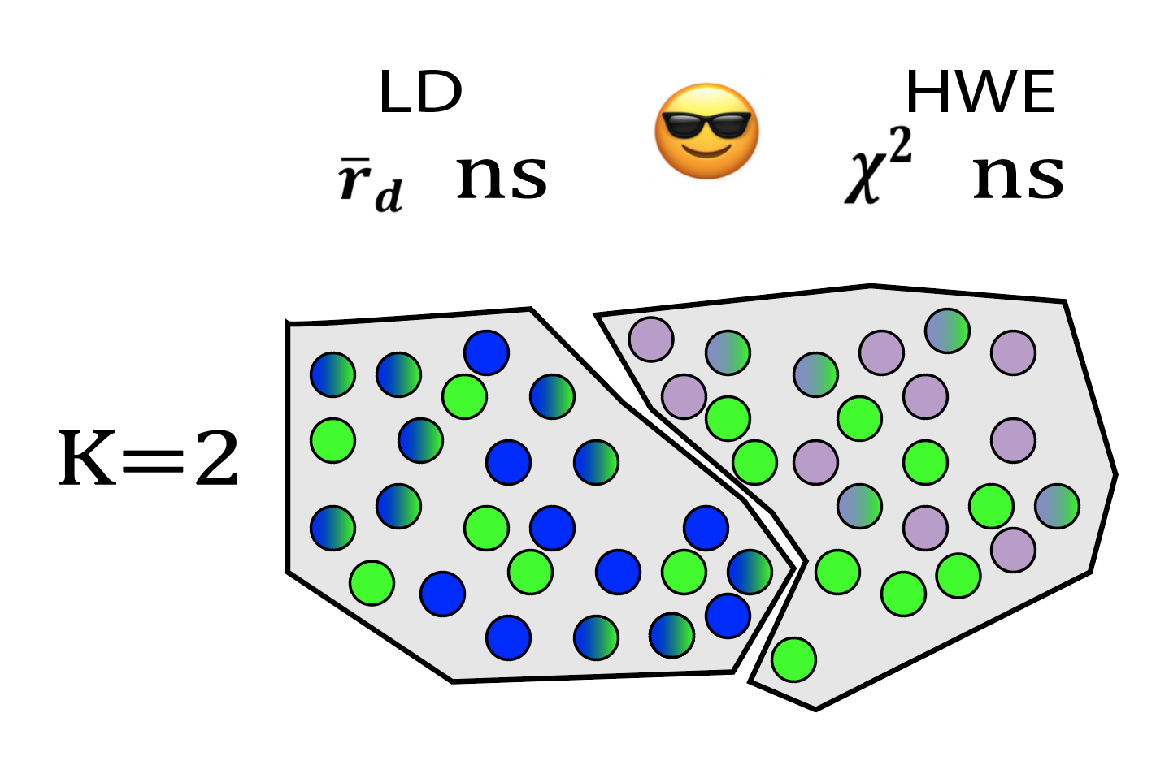

Slide 37
STRUCTURE (Pritchard et al 2000)
Process:
Randomly assign individuals to K number of populations (user defined K)
Calculate allele frequencies for the K populations
Assign individuals to populations
MCMC
Re-assign individuals to minimize LD and HWE departure
Re-estimate assignments
Repeat for X number of iterations

Slide 38
STRUCTURE (Pritchard et al 2000)
Populations are blocks

Slide 39
STRUCTURE (Pritchard et al 2000)
Individuals are bars
Populations are blocks

Slide 40
STRUCTURE (Pritchard et al 2000)
Individuals are bars
Populations are blocks
Colors are inferred populations (here K=6)

Slide 41
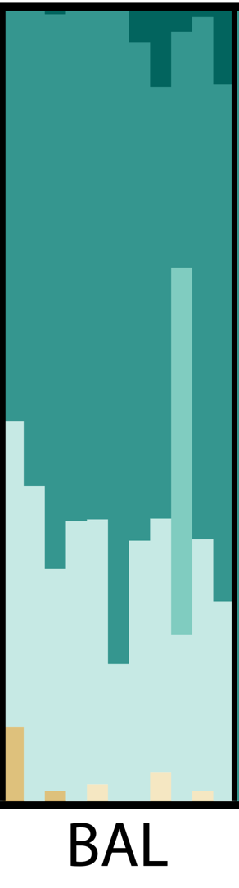
STRUCTURE (Pritchard et al 2000)
Colors represent posterior probabilities of assignment to clusters

Slide 42
STRUCTURE (Pritchard et al 2000)
Mixed assignment can result from:
Admixture
Weakly differentiated populations
Artefacts of unrealistic K values
Input from unsampled population
God

Slide 43
STRUCTURE (Pritchard et al 2000)
Critical assumptions
The chosen value of K represents real clusters in the data
The software will create any number of populations you specify, whether these represent true groups or not…
…The general scheme is to run Structure for a range of K values (e.g. 1-10), and select optimal K after

Slide 44
STRUCTURE (Pritchard et al 2000)
Critical assumptions
The chosen value of K represents real clusters in the data
Those clusters can be delimited by assuming real biological populations are in HWE and lack LD
You should be reasonably sure your loci aren’t linked (hence testing for LD)
AND be aware that anything which causes departure from HWE (e.g. bottlenecks) can affect your results

Slide 45
STRUCTURE (Pritchard et al 2000)
Critical assumptions
The chosen value of K represents real clusters in the data
Those clusters can be delimited by assuming real biological populations are in HWE and lack LD
All individuals are a composite of ancestral populations, and all of those populations are sampled
Gene flow from un-sampled populations will affect your results.

Slide 46
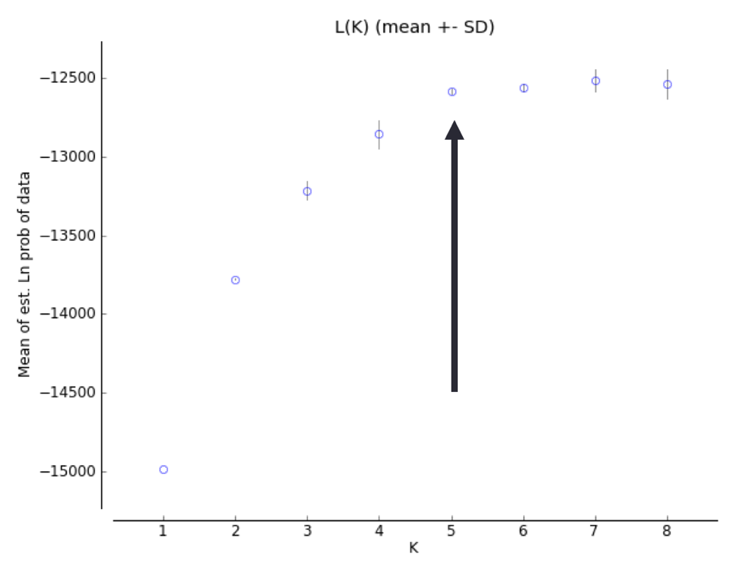
How to run Structure properly.
Problem: Value of K may not represent reality
Solution: Run multiple K values, and choose optimal K
Structure does not do this for you. Multiple methods:
Plot ln(L)
Often increases infinitely with K, look for plateau

Slide 47
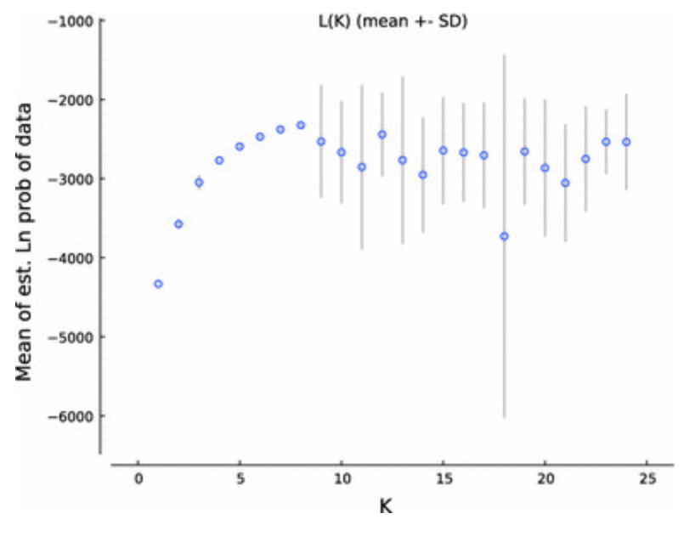
How to run Structure properly.
Problem: Value of K may not represent reality
Solution: Run multiple K values, and choose optimal K
Structure does not do this for you. Multiple methods:
Plot ln(L)
Variability among replicates generally gets very high once K exceeds anything reasonable

Slide 48
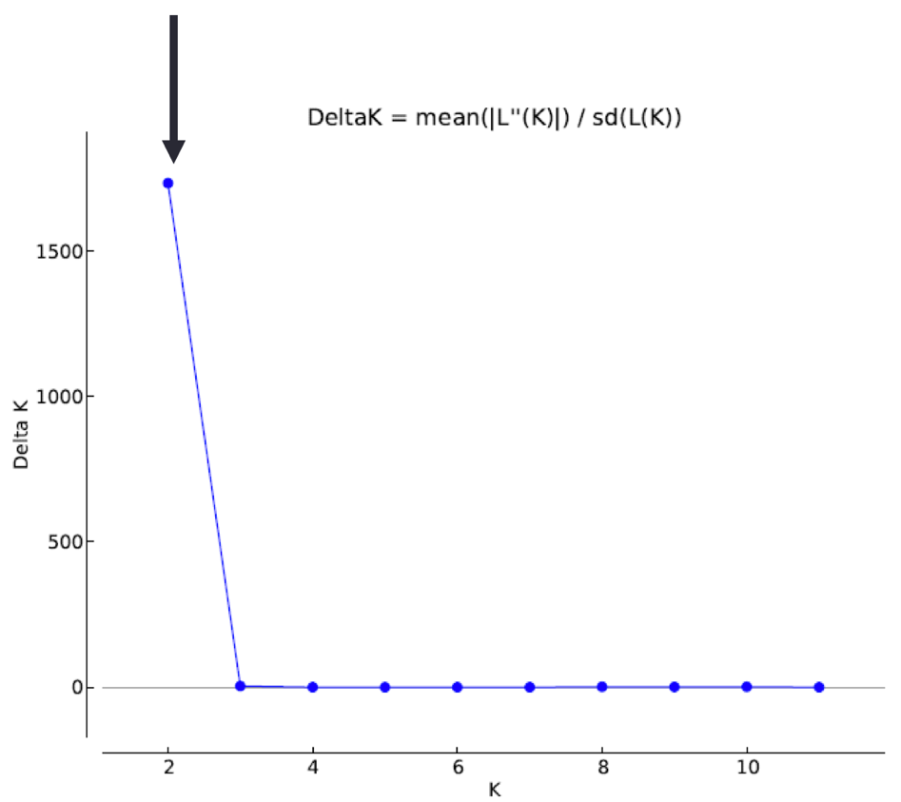
How to run Structure properly.
Problem: Value of K may not represent reality
Solution: Run multiple K values, and choose optimal K
Structure does not do this for you. Multiple methods:
Plot ln(L)
Evanno method
Needs replicates to calculate sd(L(K)), so you might have to run much longer.

Slide 49
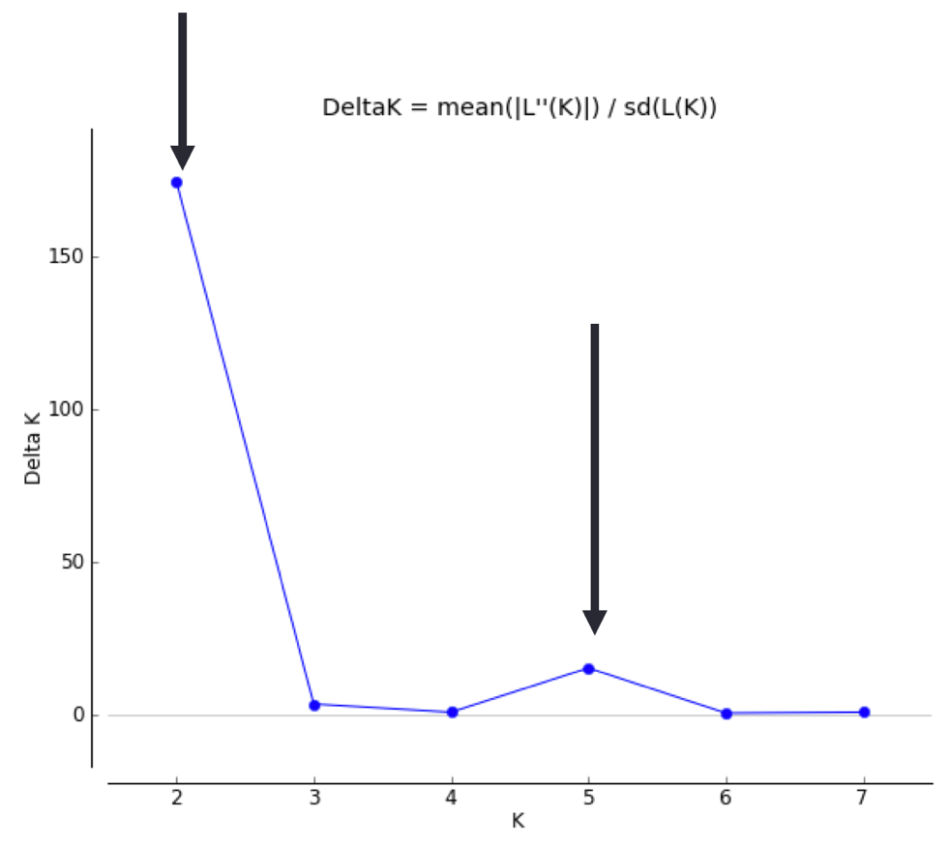
How to run Structure properly.
Problem: Value of K may not represent reality
Solution: Run multiple K values, and choose optimal K
Structure does not do this for you. Multiple methods:
Plot ln(L)
Evanno method
Can help see potential hierarchical structure

Slide 50
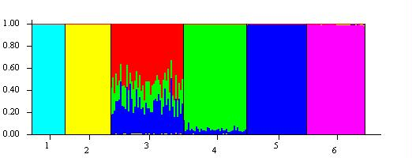
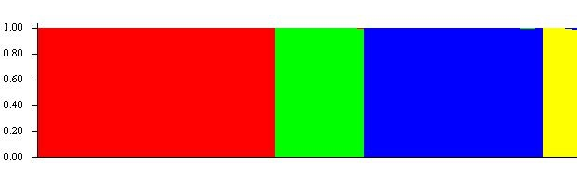
How to run Structure properly.
Problem: Model may not represent reality
Most important model selections you will make:
Ancestry model: Admixture or no admixture?
Only select “no ancestry” if you are VERY sure populations represent non-breeding groups.

Slide 51
How to run Structure properly.
Problem: Model may not represent reality
Most important model selections you will make:
Ancestry model: Admixture or no admixture?
Allele frequency model: Correlated/ Uncorrelated?
Similarly, we can constrain allele frequencies among populations to be independent of one another (uncorrelated), or correlated (e.g. due to gene flow).
Use your biological knowledge. There is no equivalent to JModelTest for Structure.

Slide 52
How to run Structure properly.
Problem: Model may not represent reality
Most important model selections you will make:
Ancestry model: Admixture or no admixture?
Allele frequency model: Correlated/ Uncorrelated?
Population Priors: LOCPRIOR or no LOCPRIOR
Structure can use a priori assignments (e.g. by location, or according to your pre-conceived notions) to inform population delimitation…
Warning: With weak data, the priors will over-ride the signal.

Slide 53
How to run Structure properly.
Problem: Model may not represent reality
Most important model selections you will make:
Ancestry model: Admixture or no admixture?
Allele frequency model: Correlated/ Uncorrelated?
Population Priors: LOCPRIOR or no LOCPRIOR
MCMC length and sampling
With all MCMC methods, you must assess for mixing and autocorrelation afterwards. Unfortunately, Structure (via the command-line) does not report complete trace files

Slide 54
How to NOT to run Structure properly
Oversample your focal population so it drives patterns of allele frequency
Choose value of K which gives results closest to you’re a priori expectations
Favorite population not distinct? No problem! Just increase K until it is!
Fabricate signal in weak data using informative priors!
Lawson et al (2018) bioRxiv: A tutorial on how (not) to over-interpret STRUCTURE/ADMIXTURE bar plots

